Slide 1
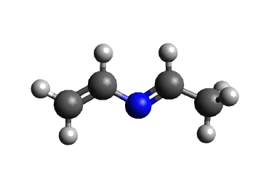
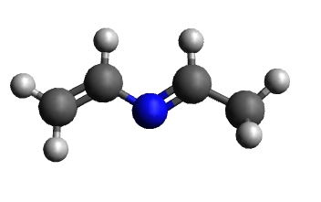
Performance comparisons for Gaussian16 geometry optimisation with Hessians
11 Dec 2023

Slide 2
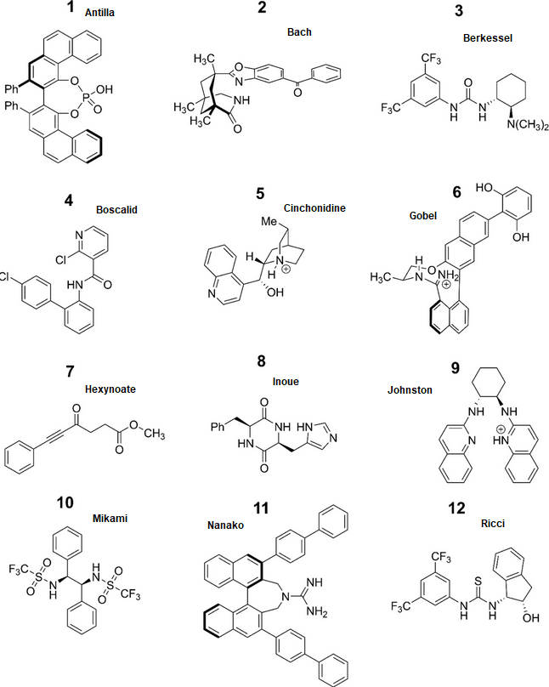
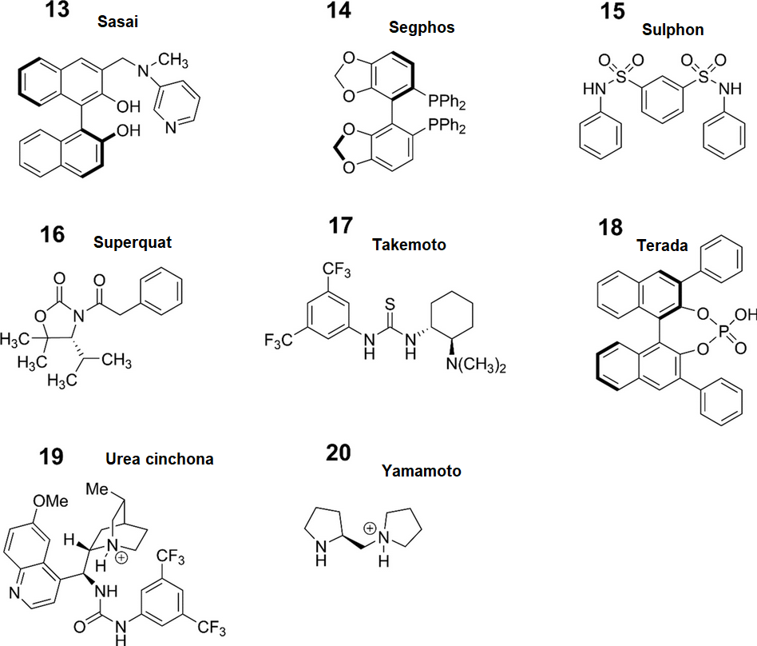
Data: Catalyst-20 (OPLS3e)
Lewis-Atwell, T., Townsend, P.A. and Grayson, M.N., 2022. Comparing the Performances of Force Fields in Conformational Searching of Hydrogen-Bond-Donating Catalysts. The Journal of Organic Chemistry, 87(9), pp.5703-5712.

Slide 3
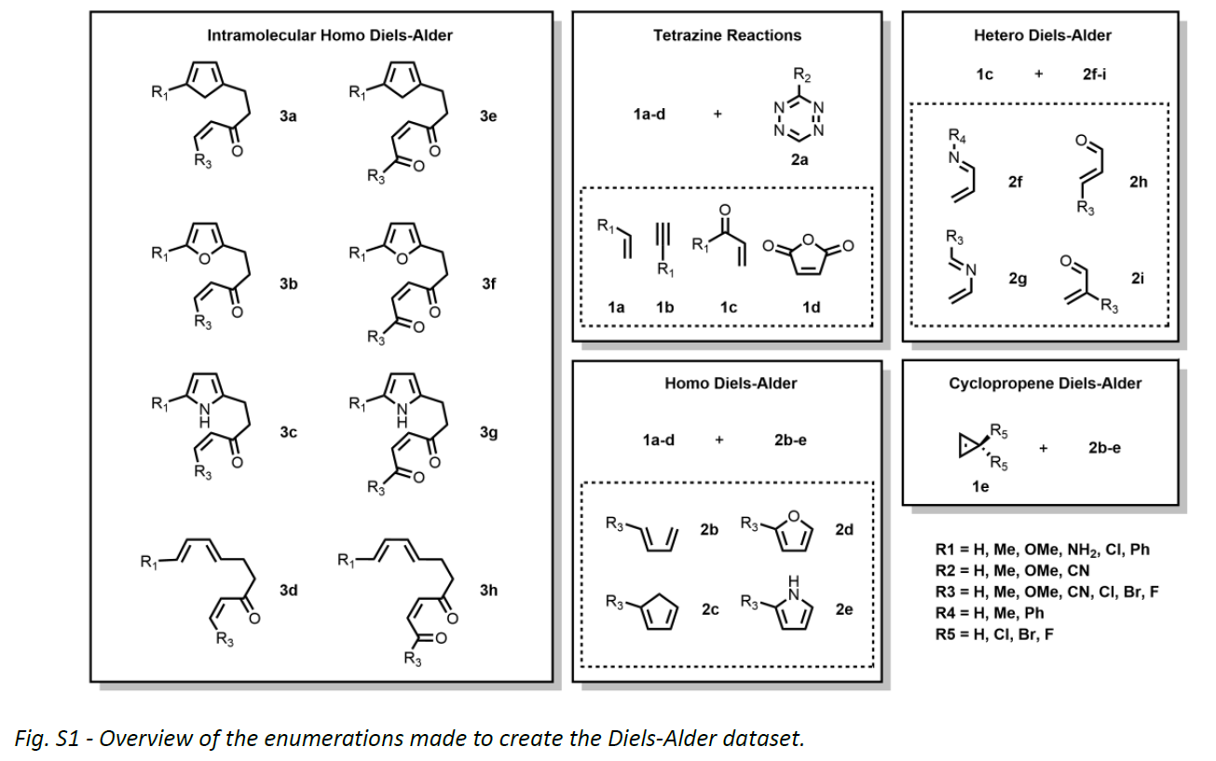
Data: Dienes-9, Dienophiles-5, Intra-8 (OPLS3e)
Dienes-9:
2x-2 (R3/R4=Me)
Dienophiles-5:
1x-2 (R1=Me)
1d
Intra-8:
3x-1 (R1=R3=H)
Espley, S.G., Farrar, E.H., Buttar, D., Tomasi, S. and Grayson, M.N., 2023. Machine learning reaction barriers in low data regimes: a horizontal and diagonal transfer learning approach. Digital Discovery.

Slide 4
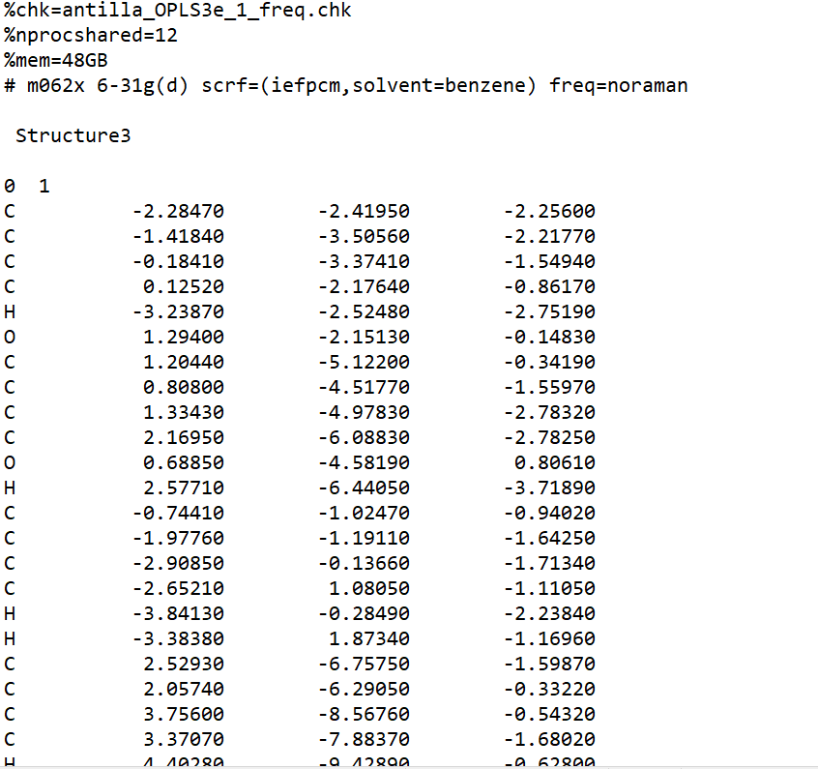
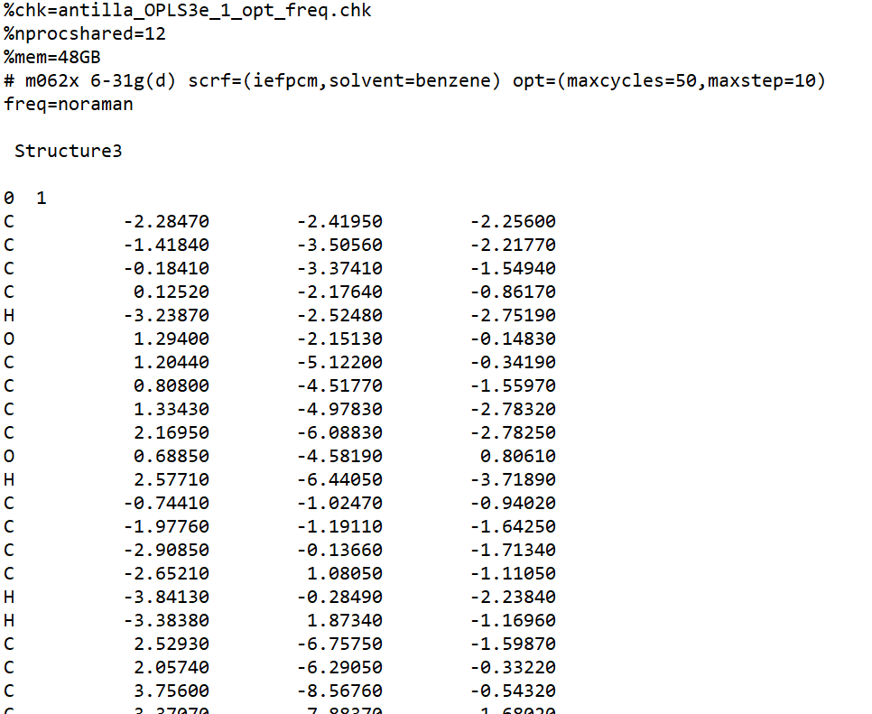
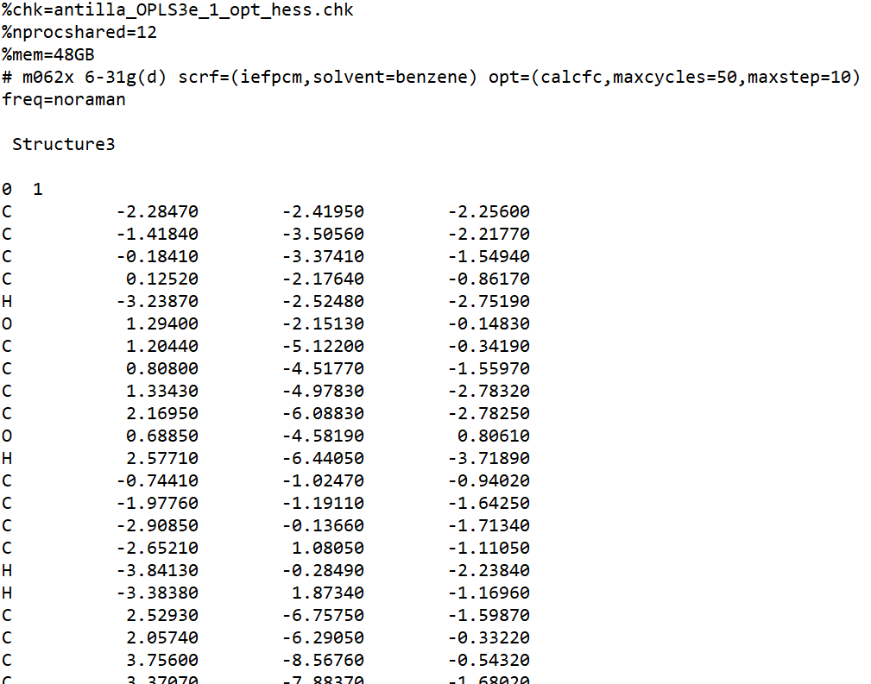
Level of theory: M062x/6-31G(d)
The same level of theory as used in JOC paper.
Lewis-Atwell, T., Townsend, P.A. and Grayson, M.N., 2022. Comparing the Performances of Force Fields in Conformational Searching of Hydrogen-Bond-Donating Catalysts. The Journal of Organic Chemistry, 87(9), pp.5703-5712.
freq
opt_freq
opt_hess

Slide 5
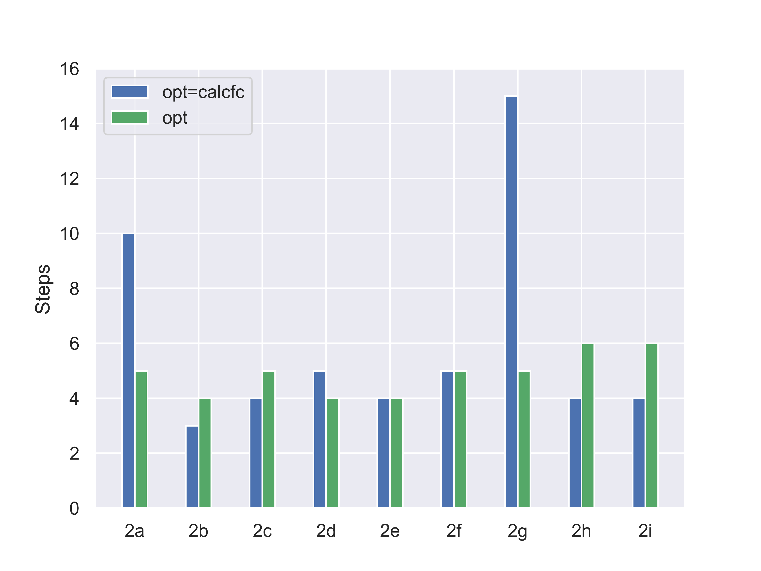
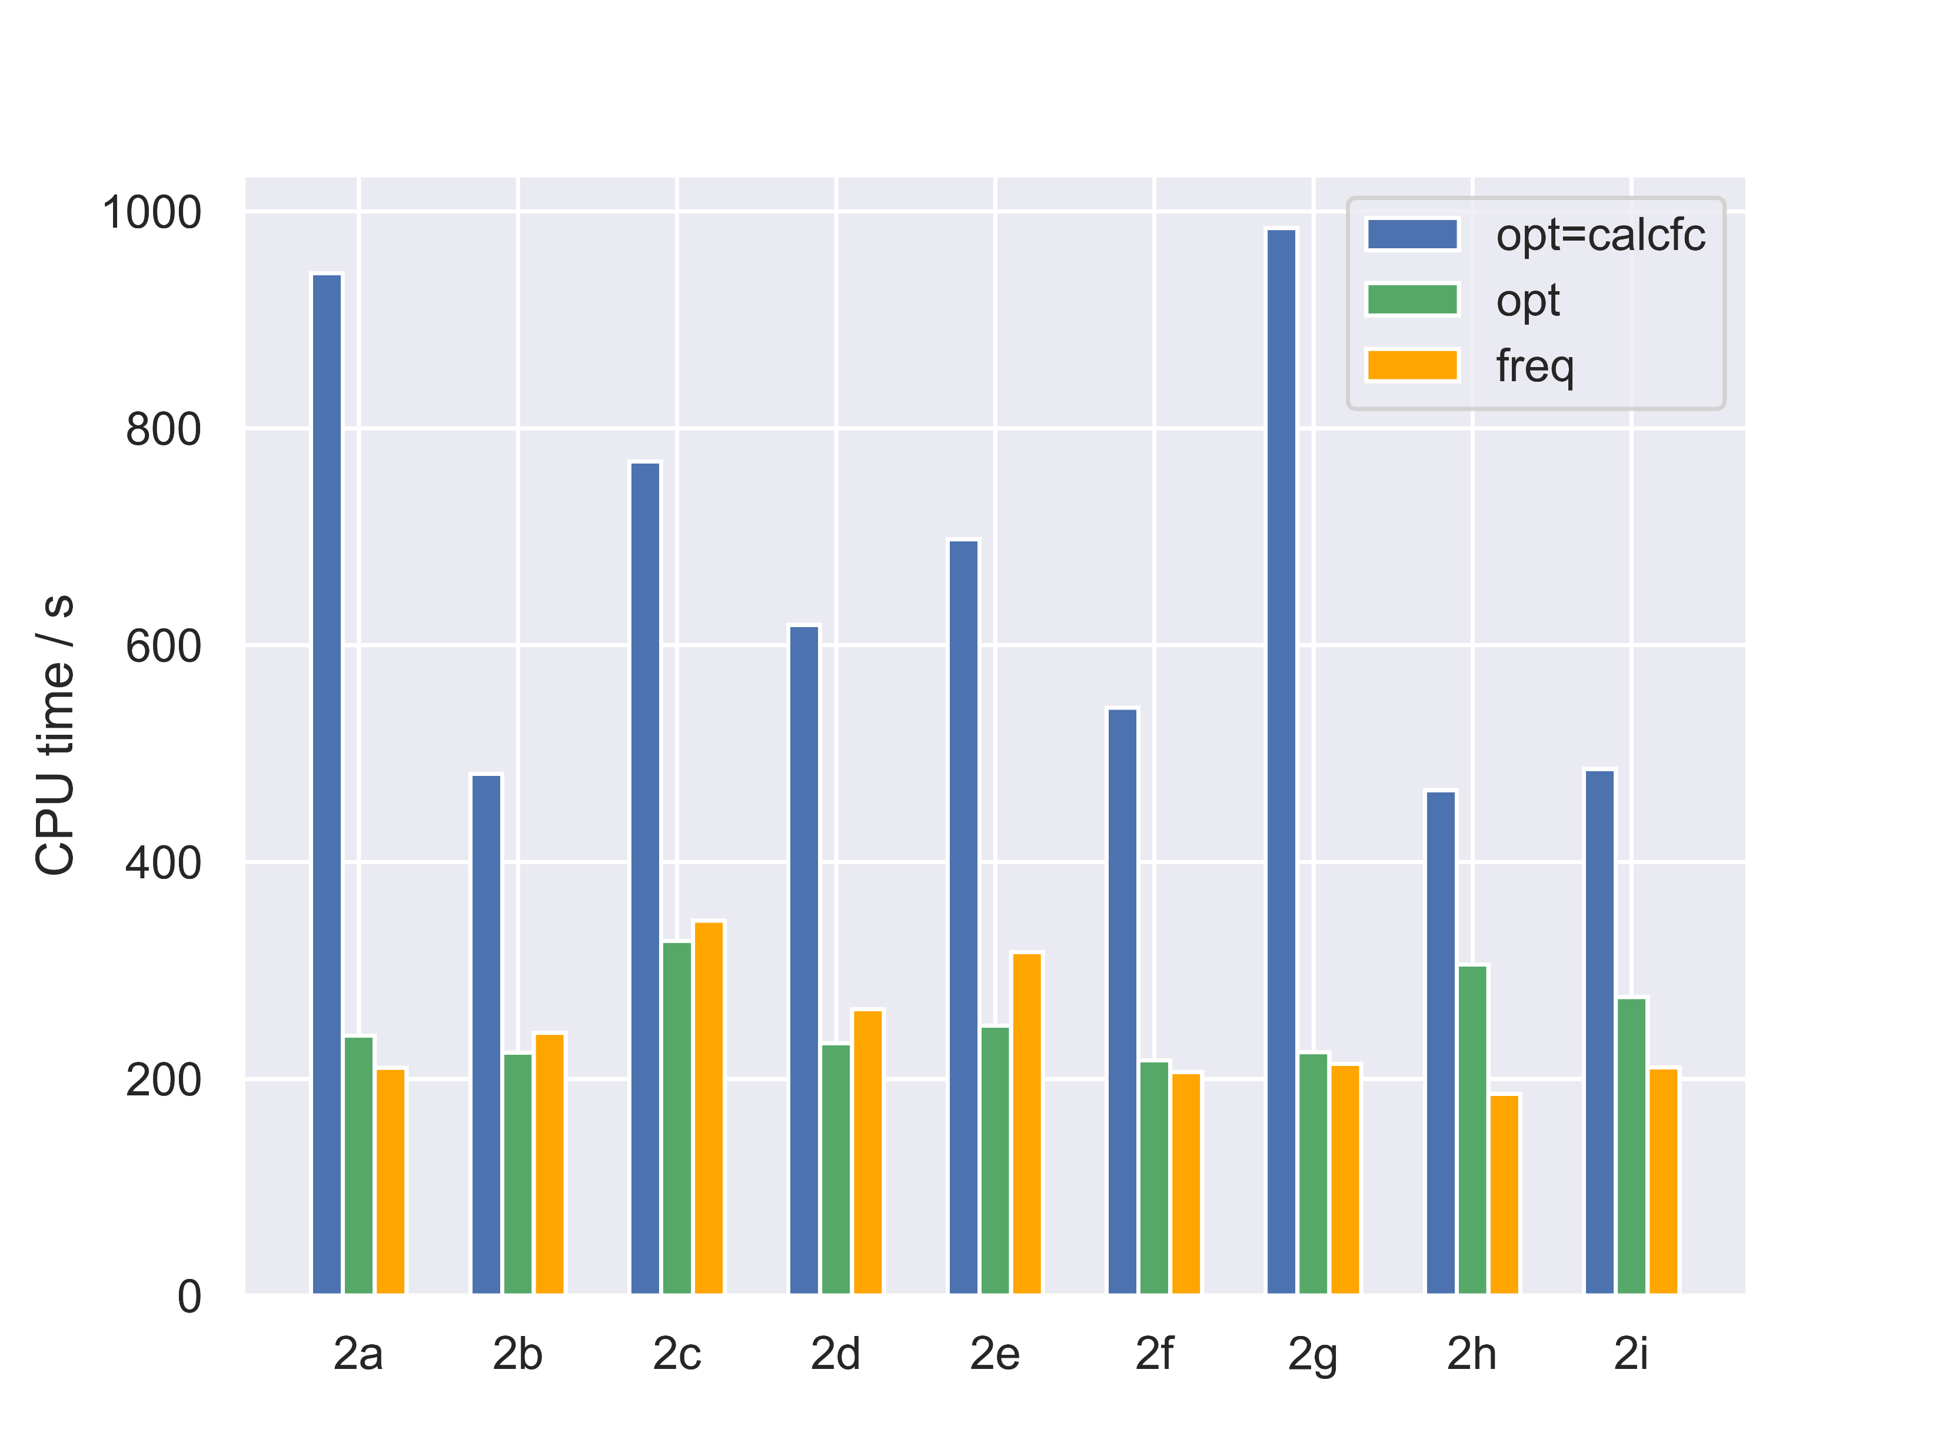
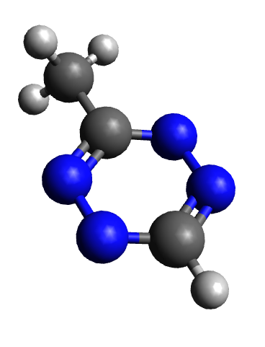
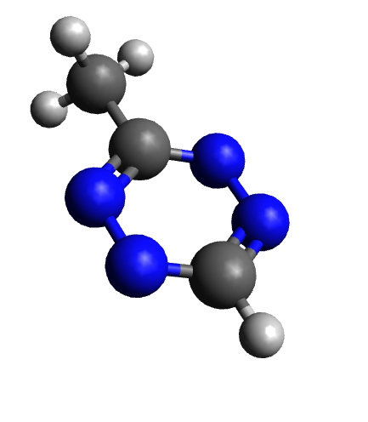
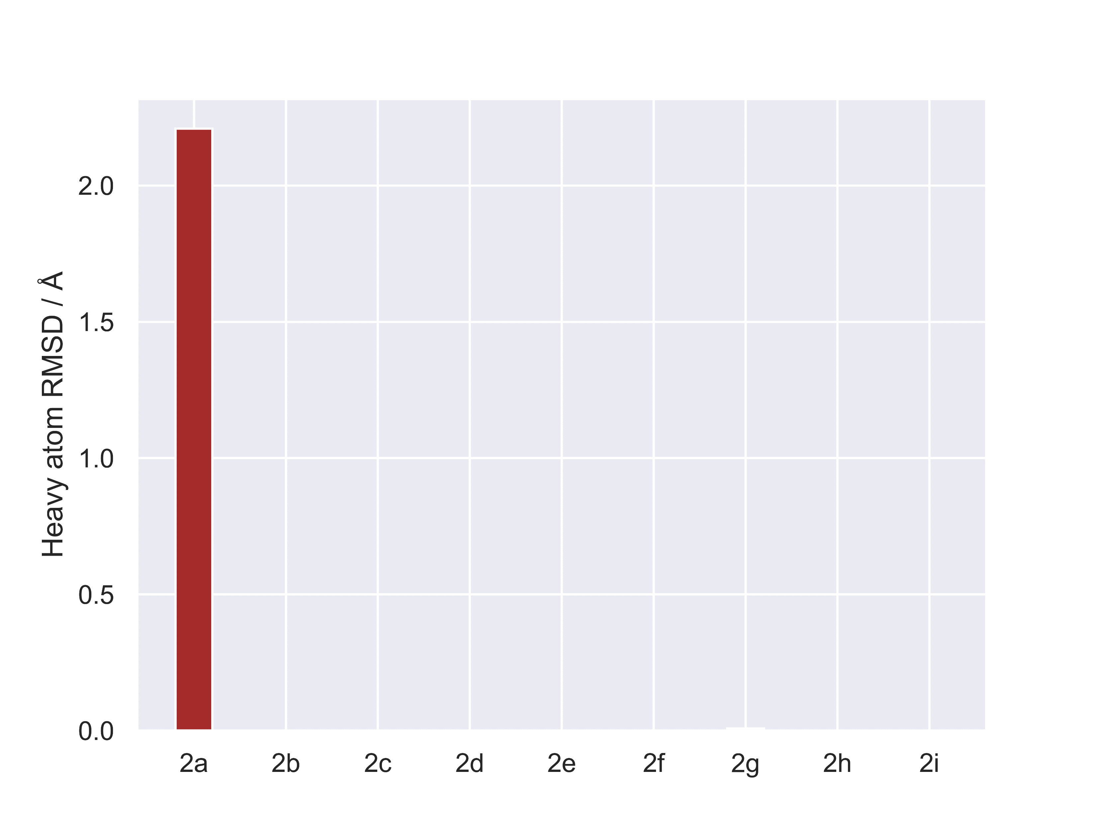
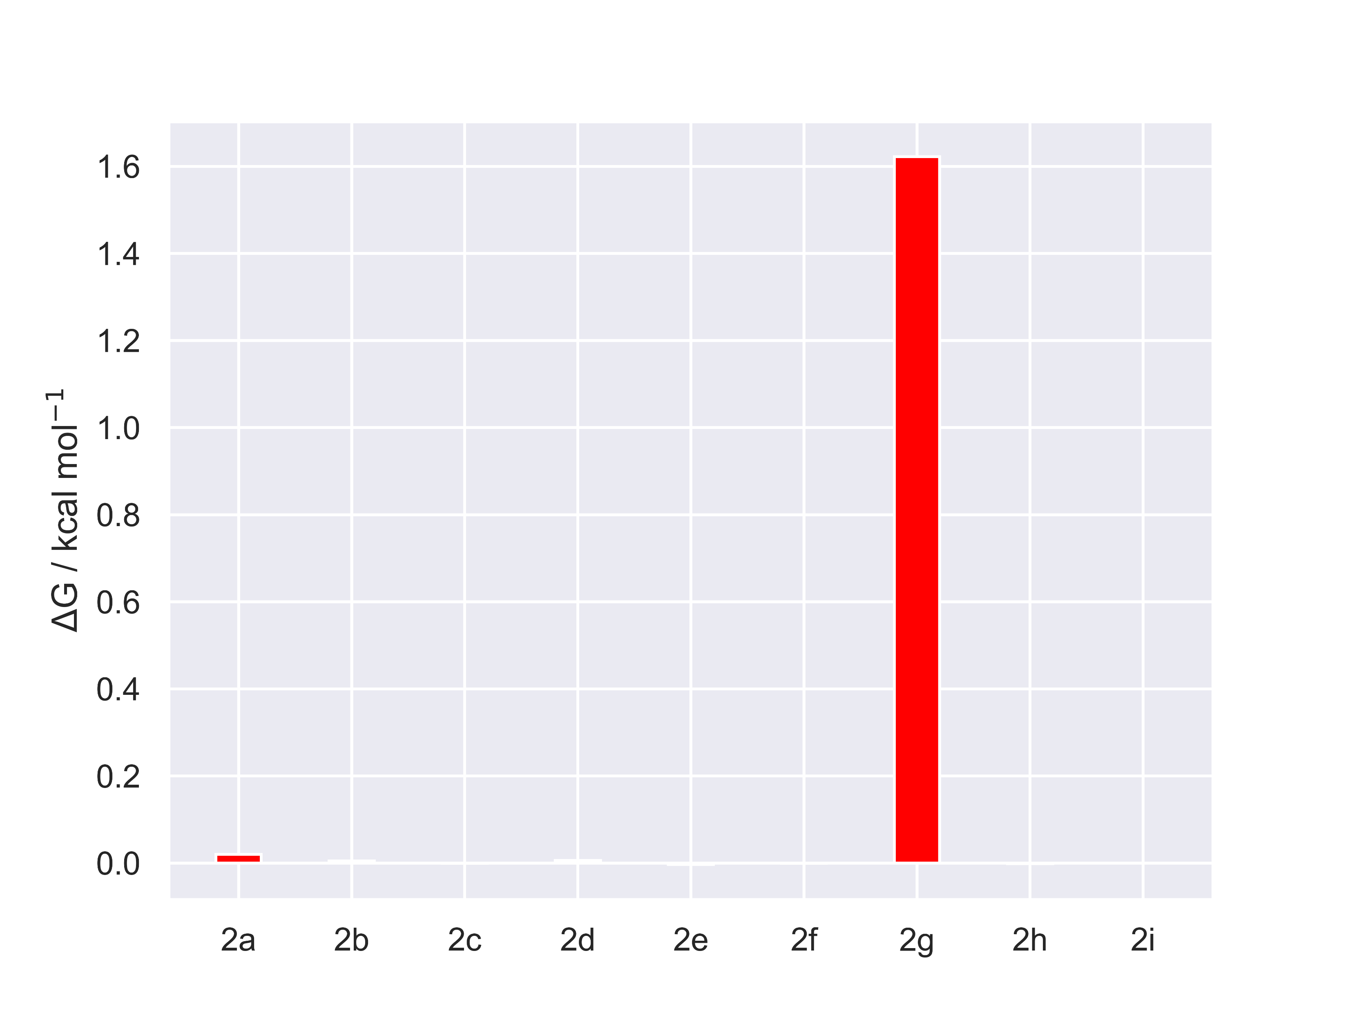
Dienes-9: results
n.b in the following slides: ΔG = G_{(opt)} – G_{(opt=calcfc)}
2a-opt 2a-opt=calcfc
*
*
2g-opt 2g-opt=calcfc
anti-Houk (wrong)
Houk (correct)

Slide 6
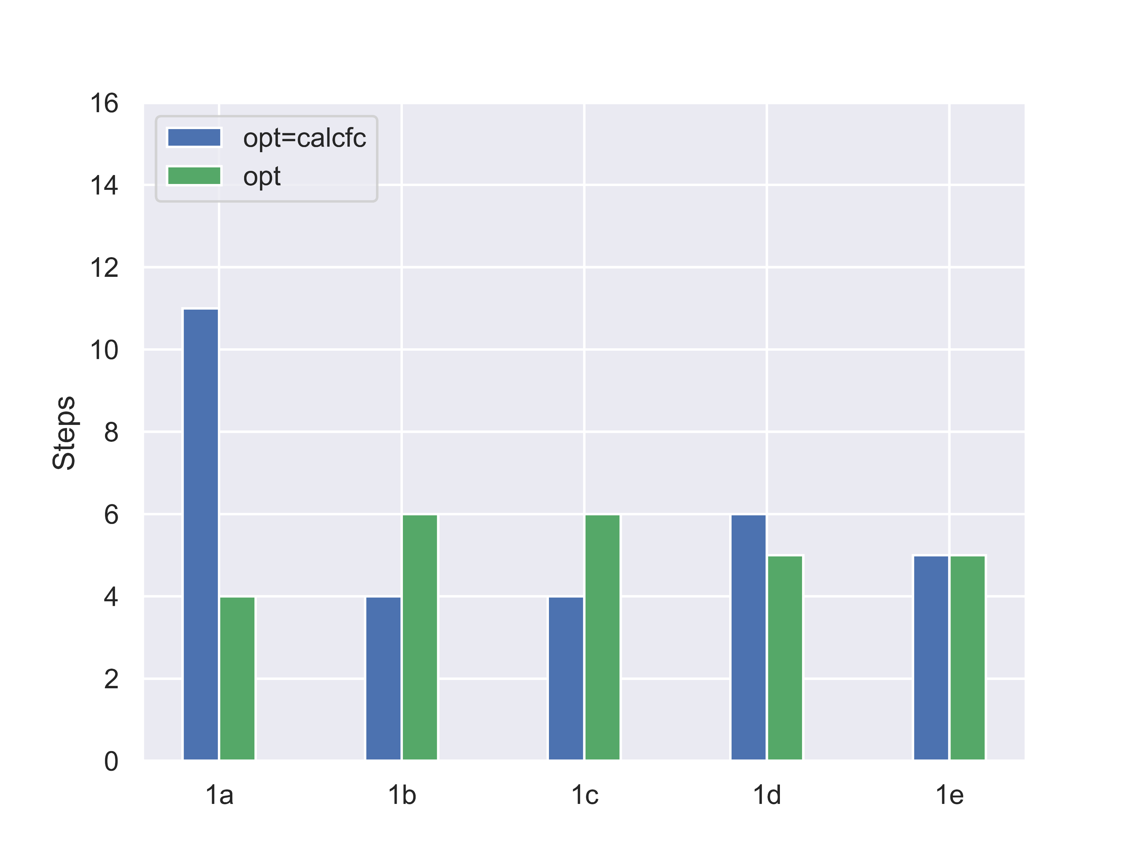
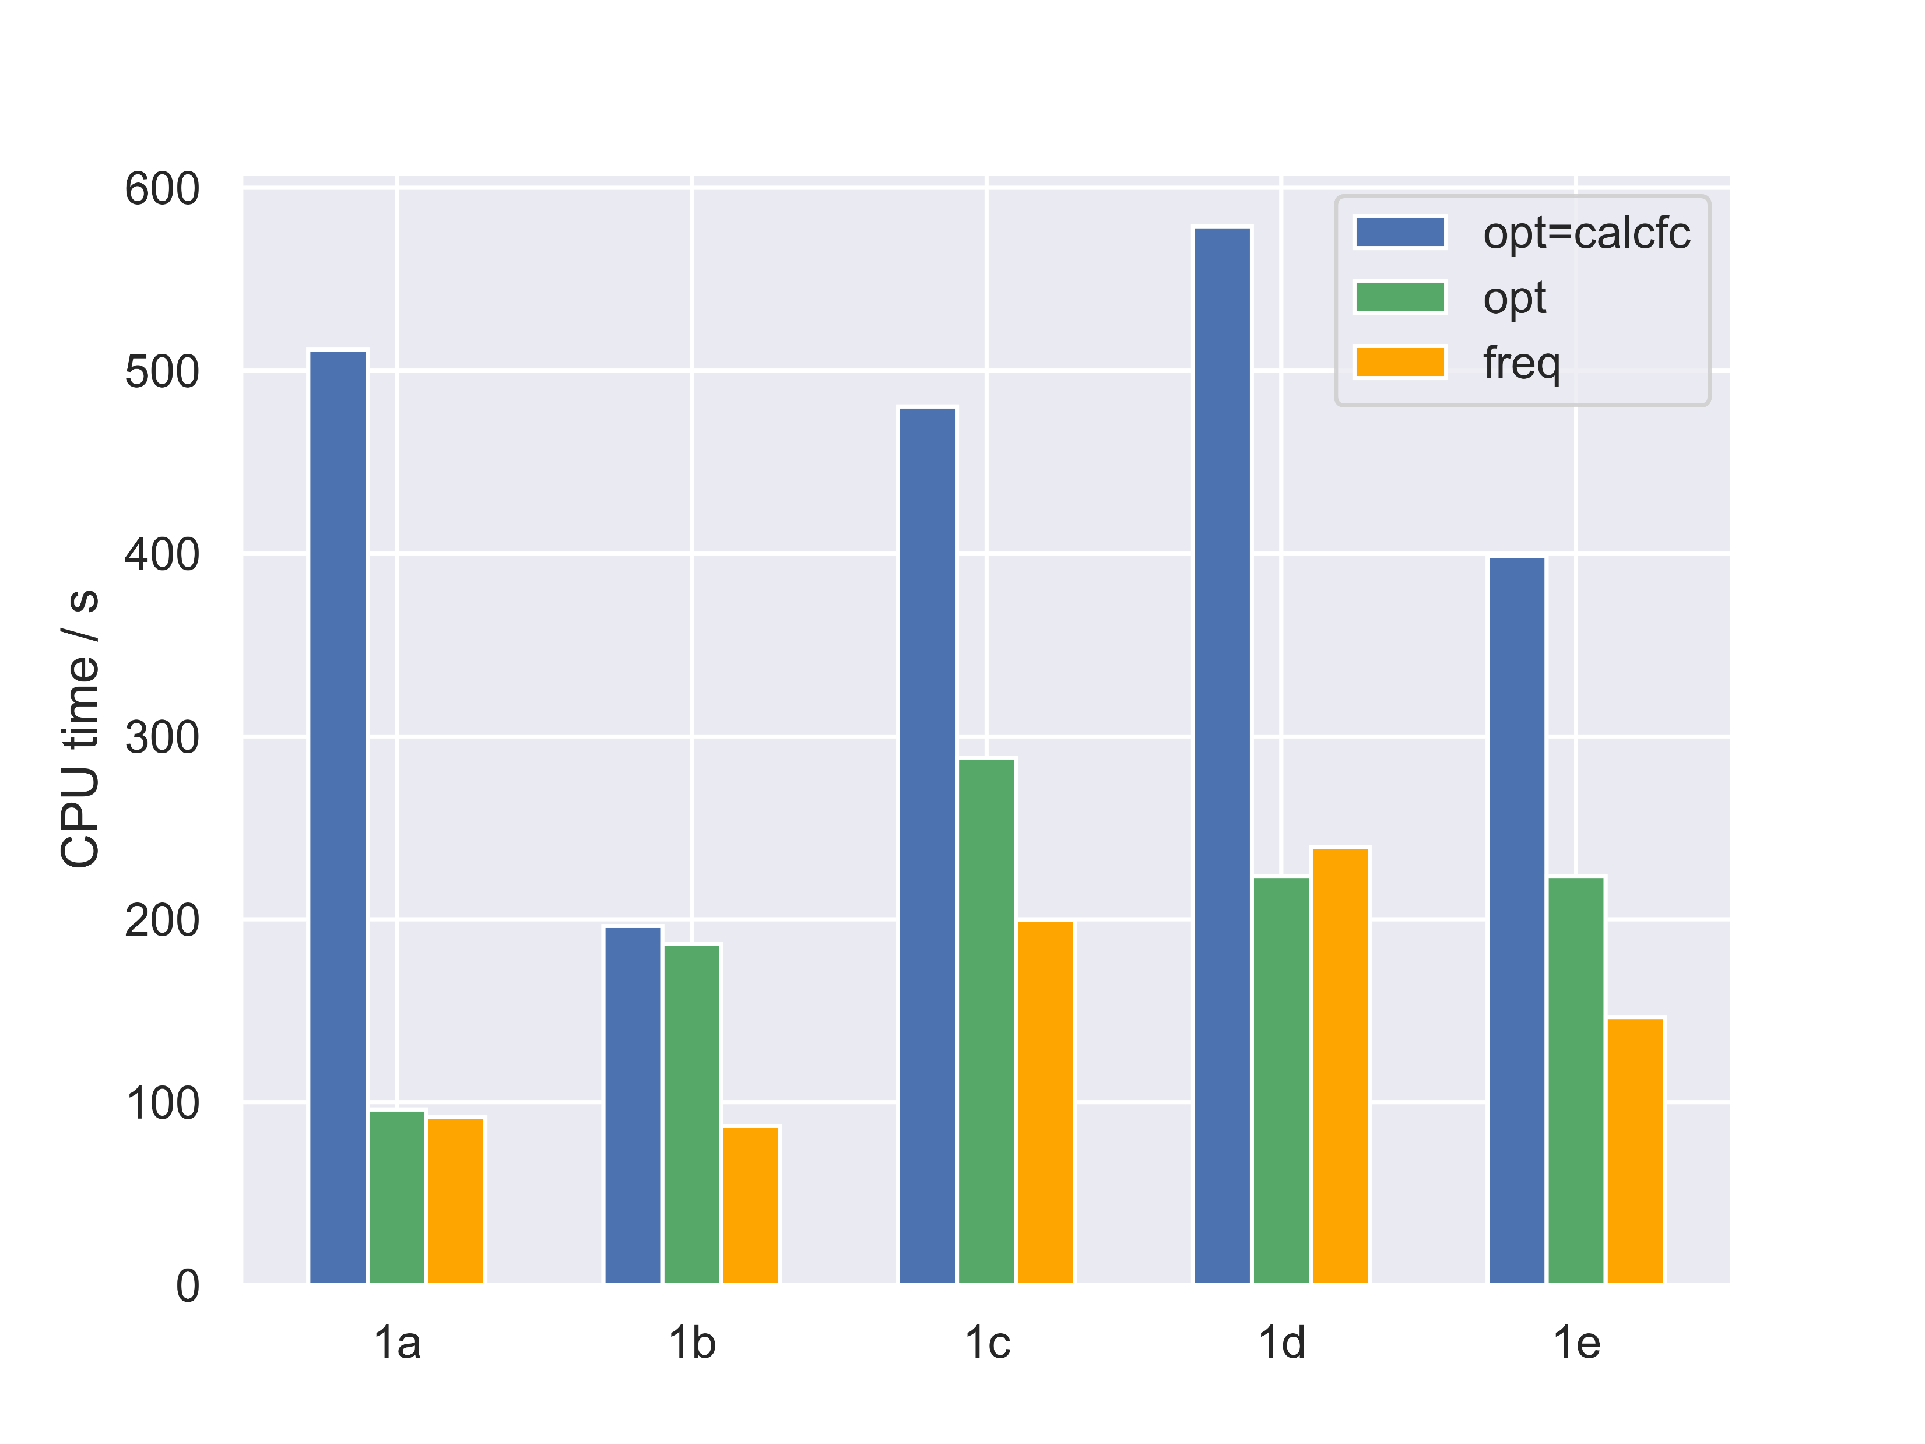
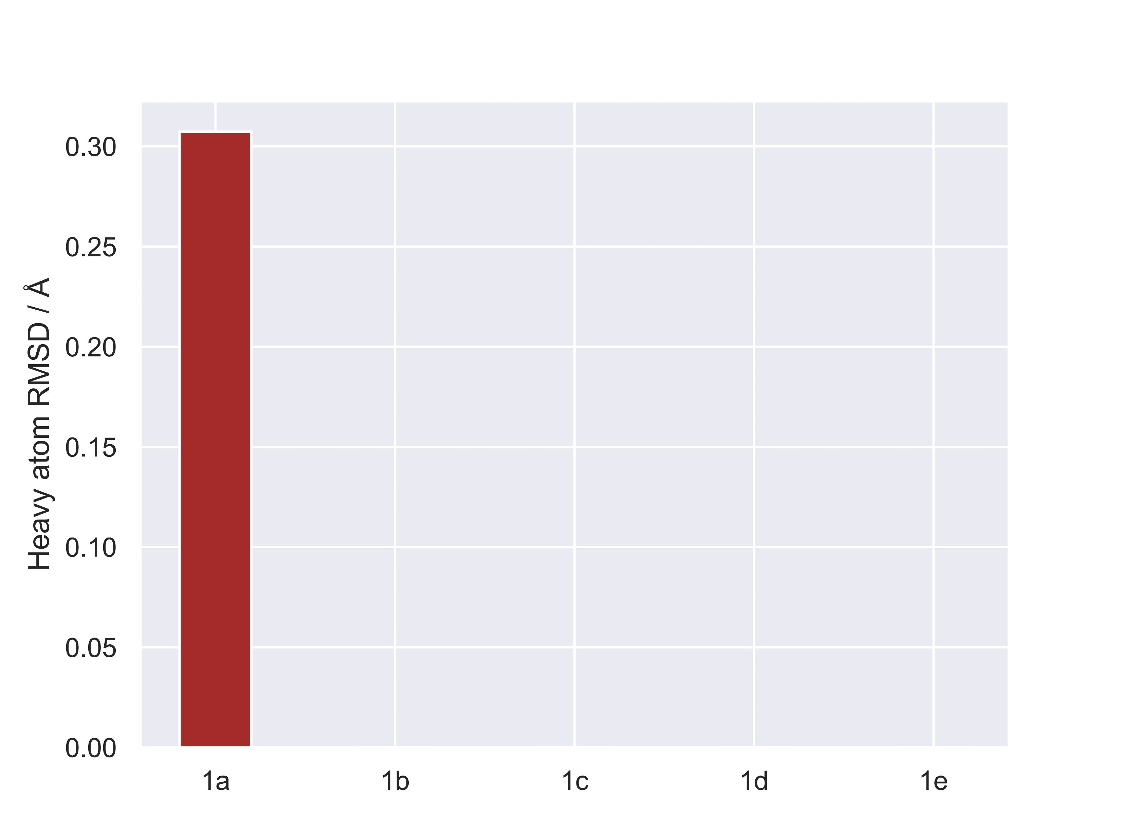
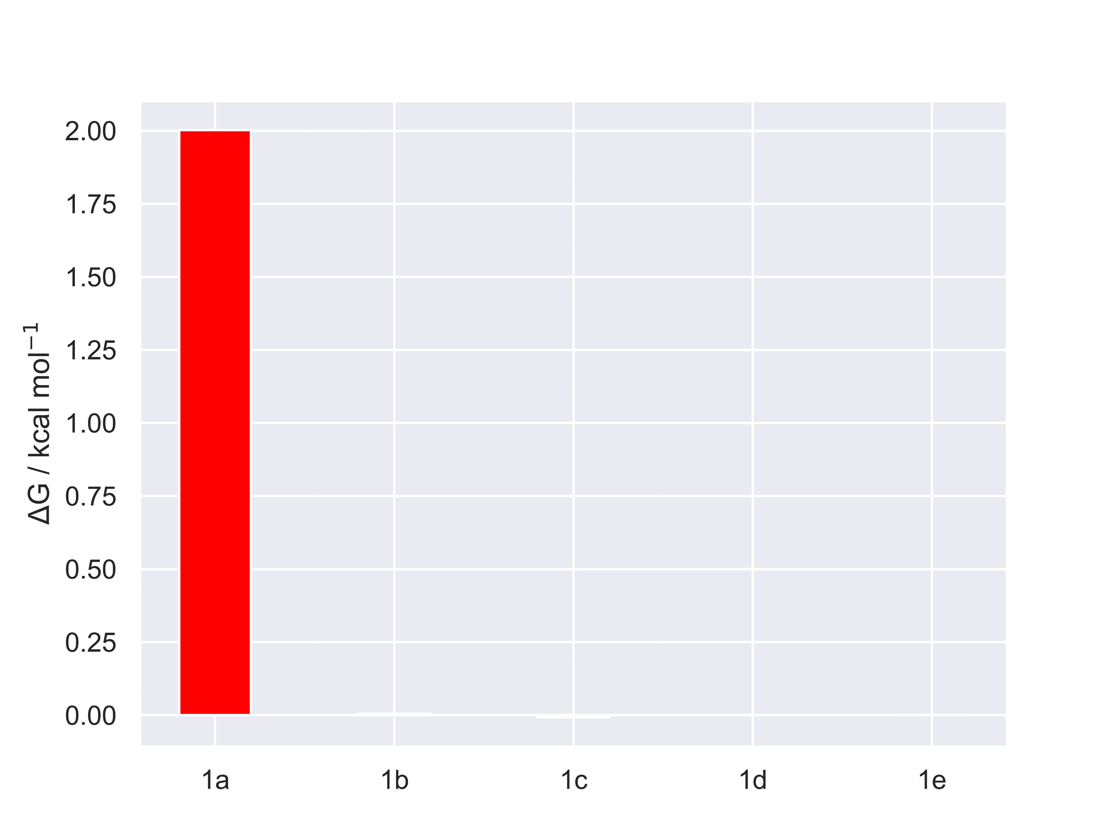
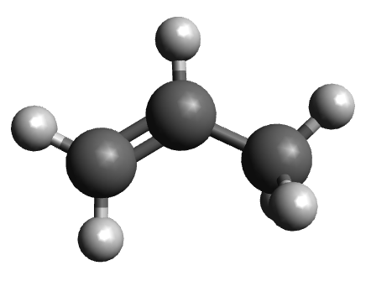
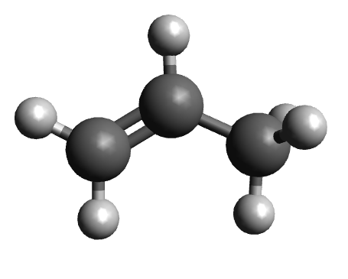
Dienophiles-5: results
1a-opt 1a-opt=calcfc
*
*
anti-Houk (wrong)
Houk (correct)

Slide 7
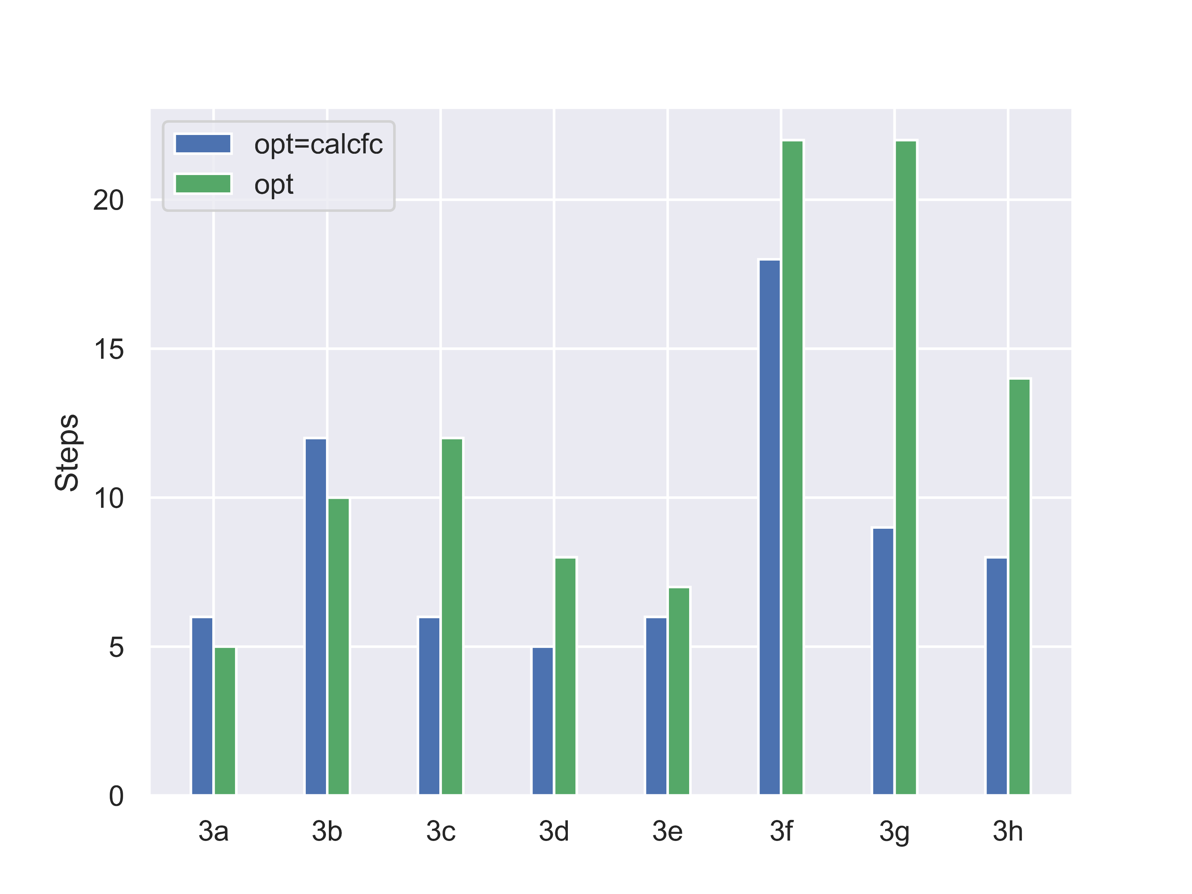
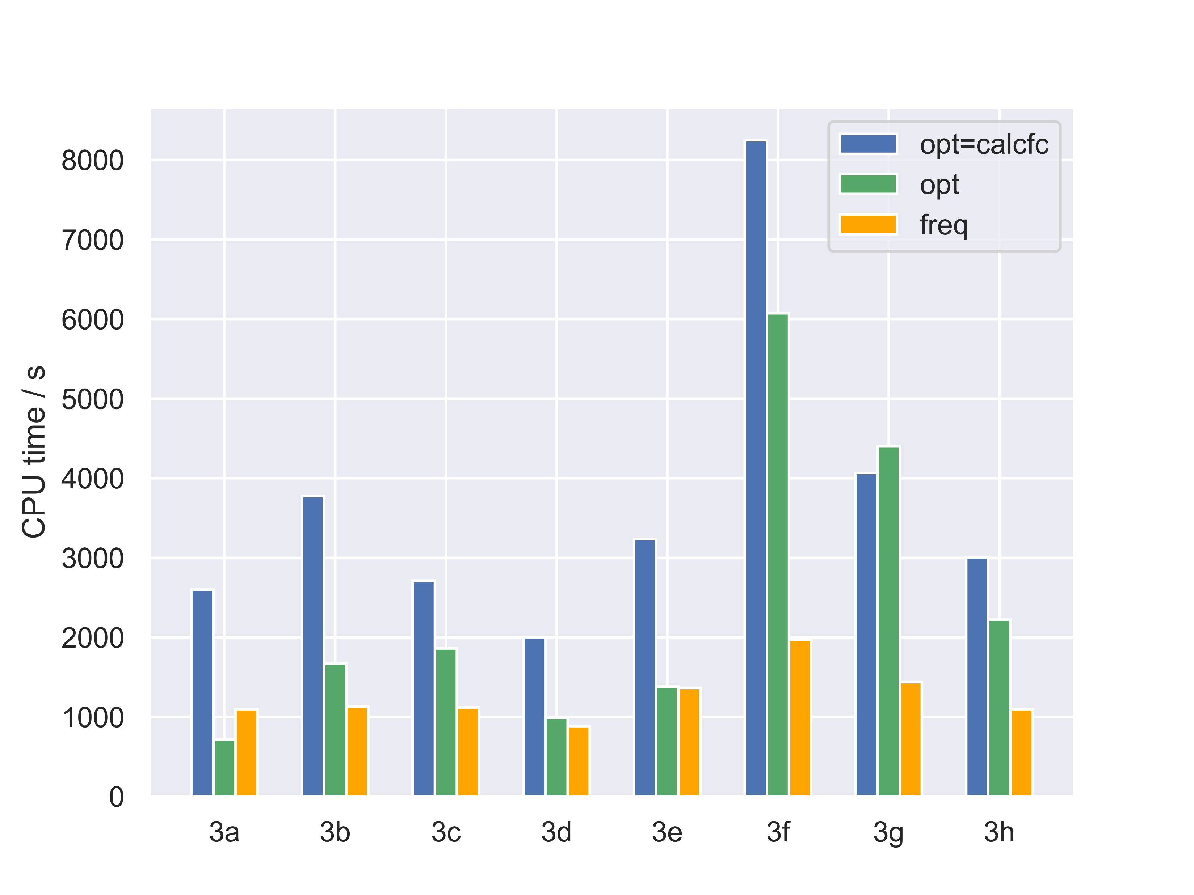
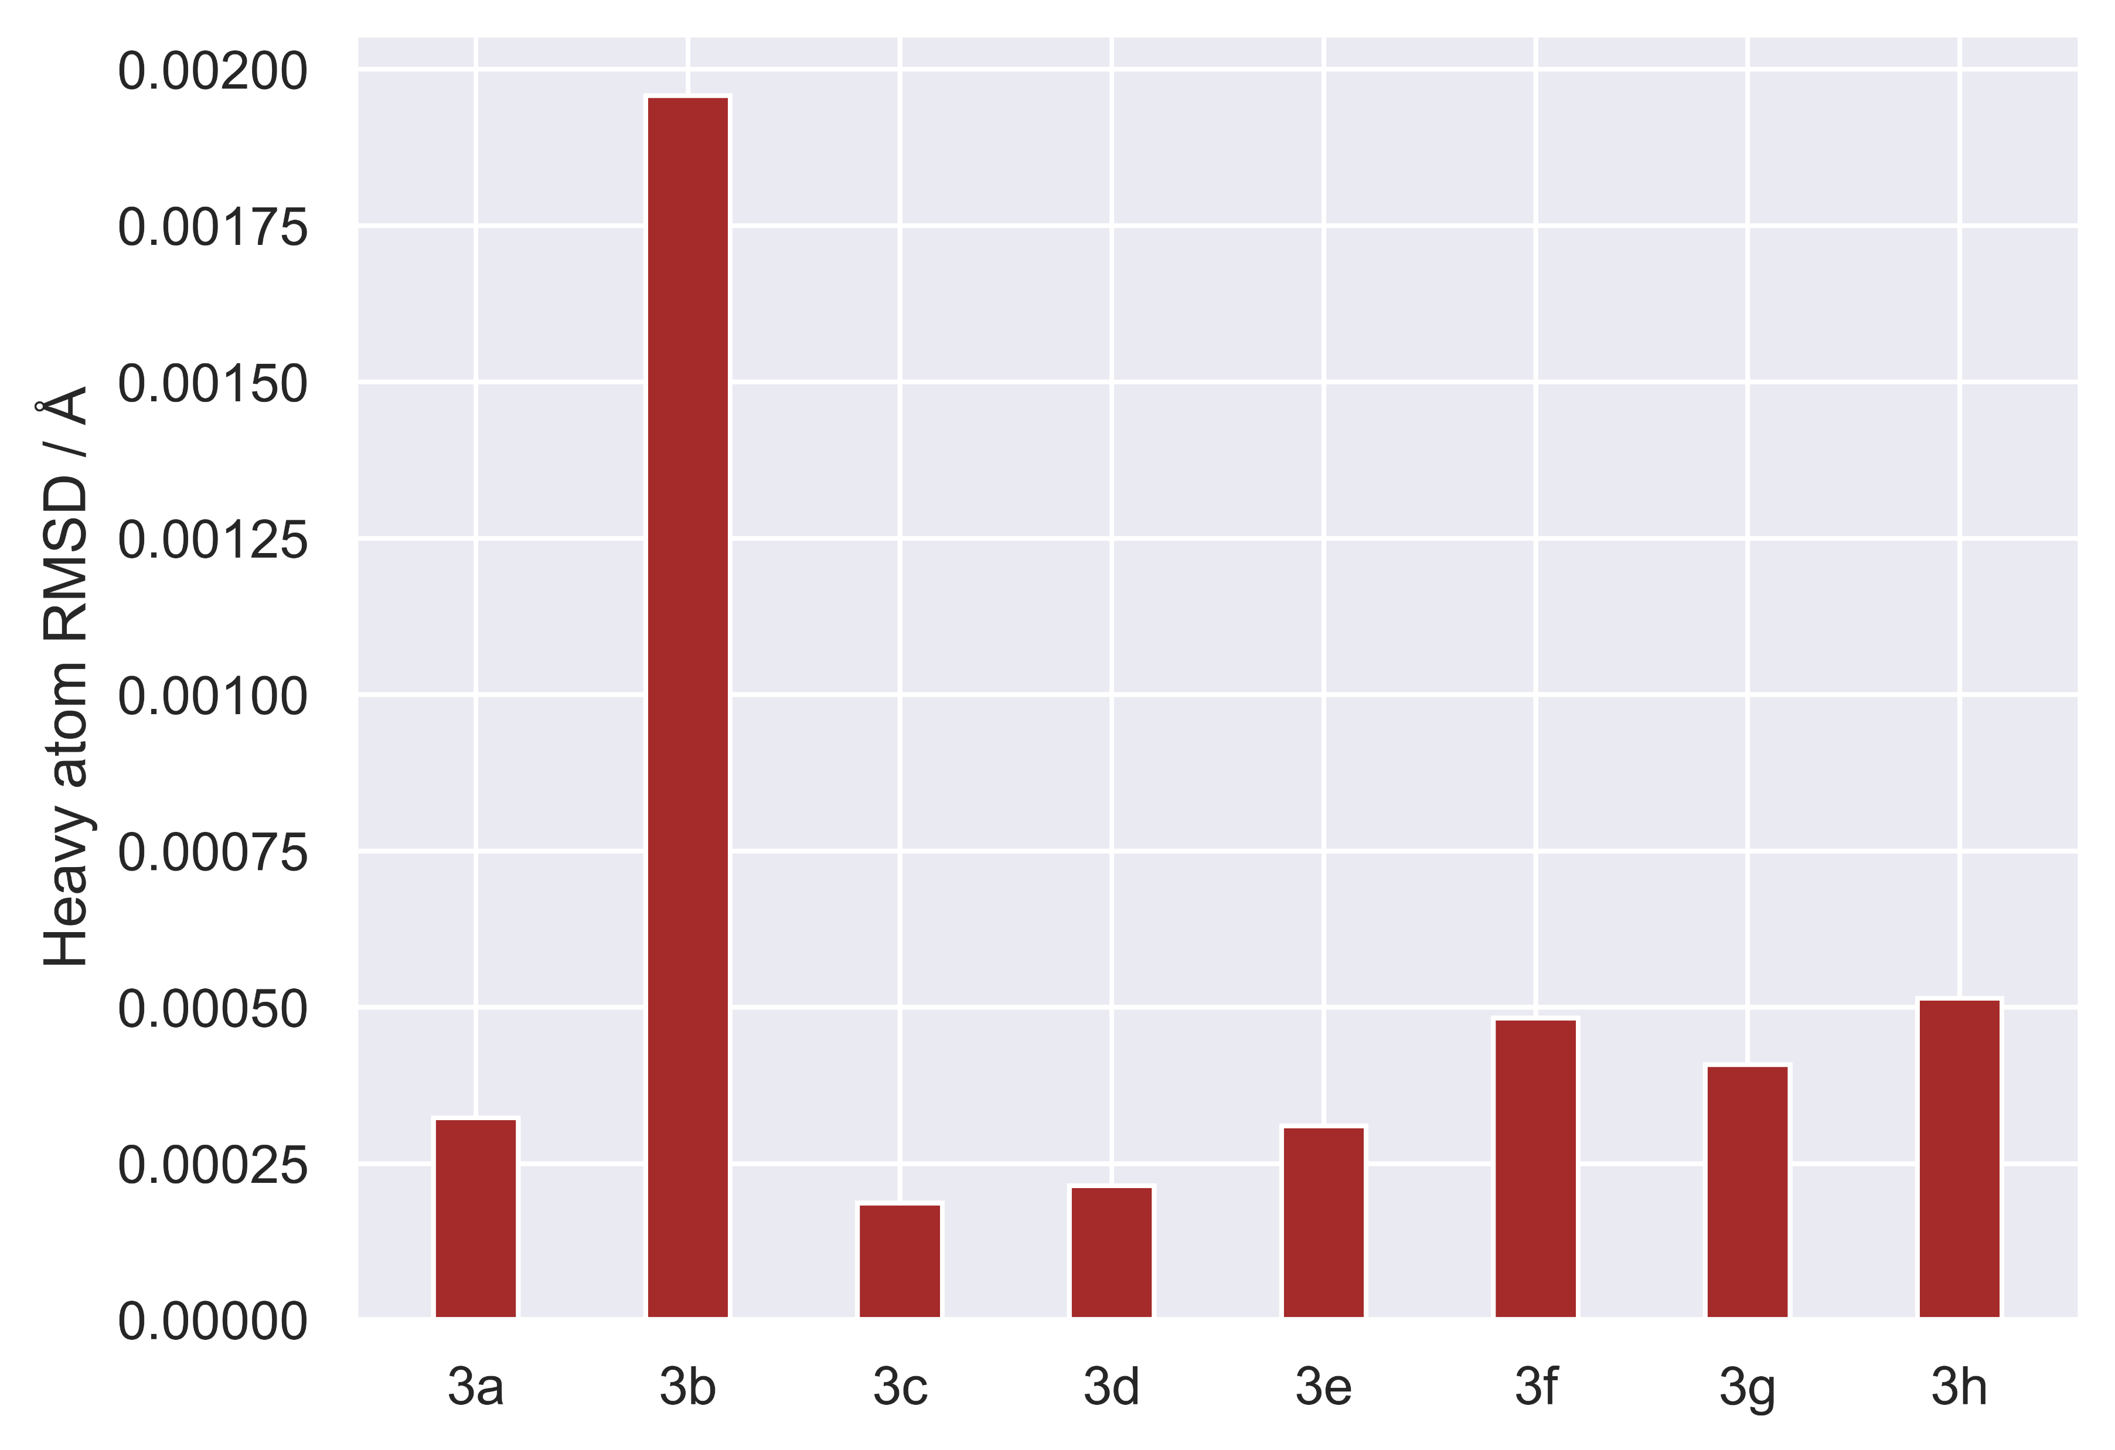
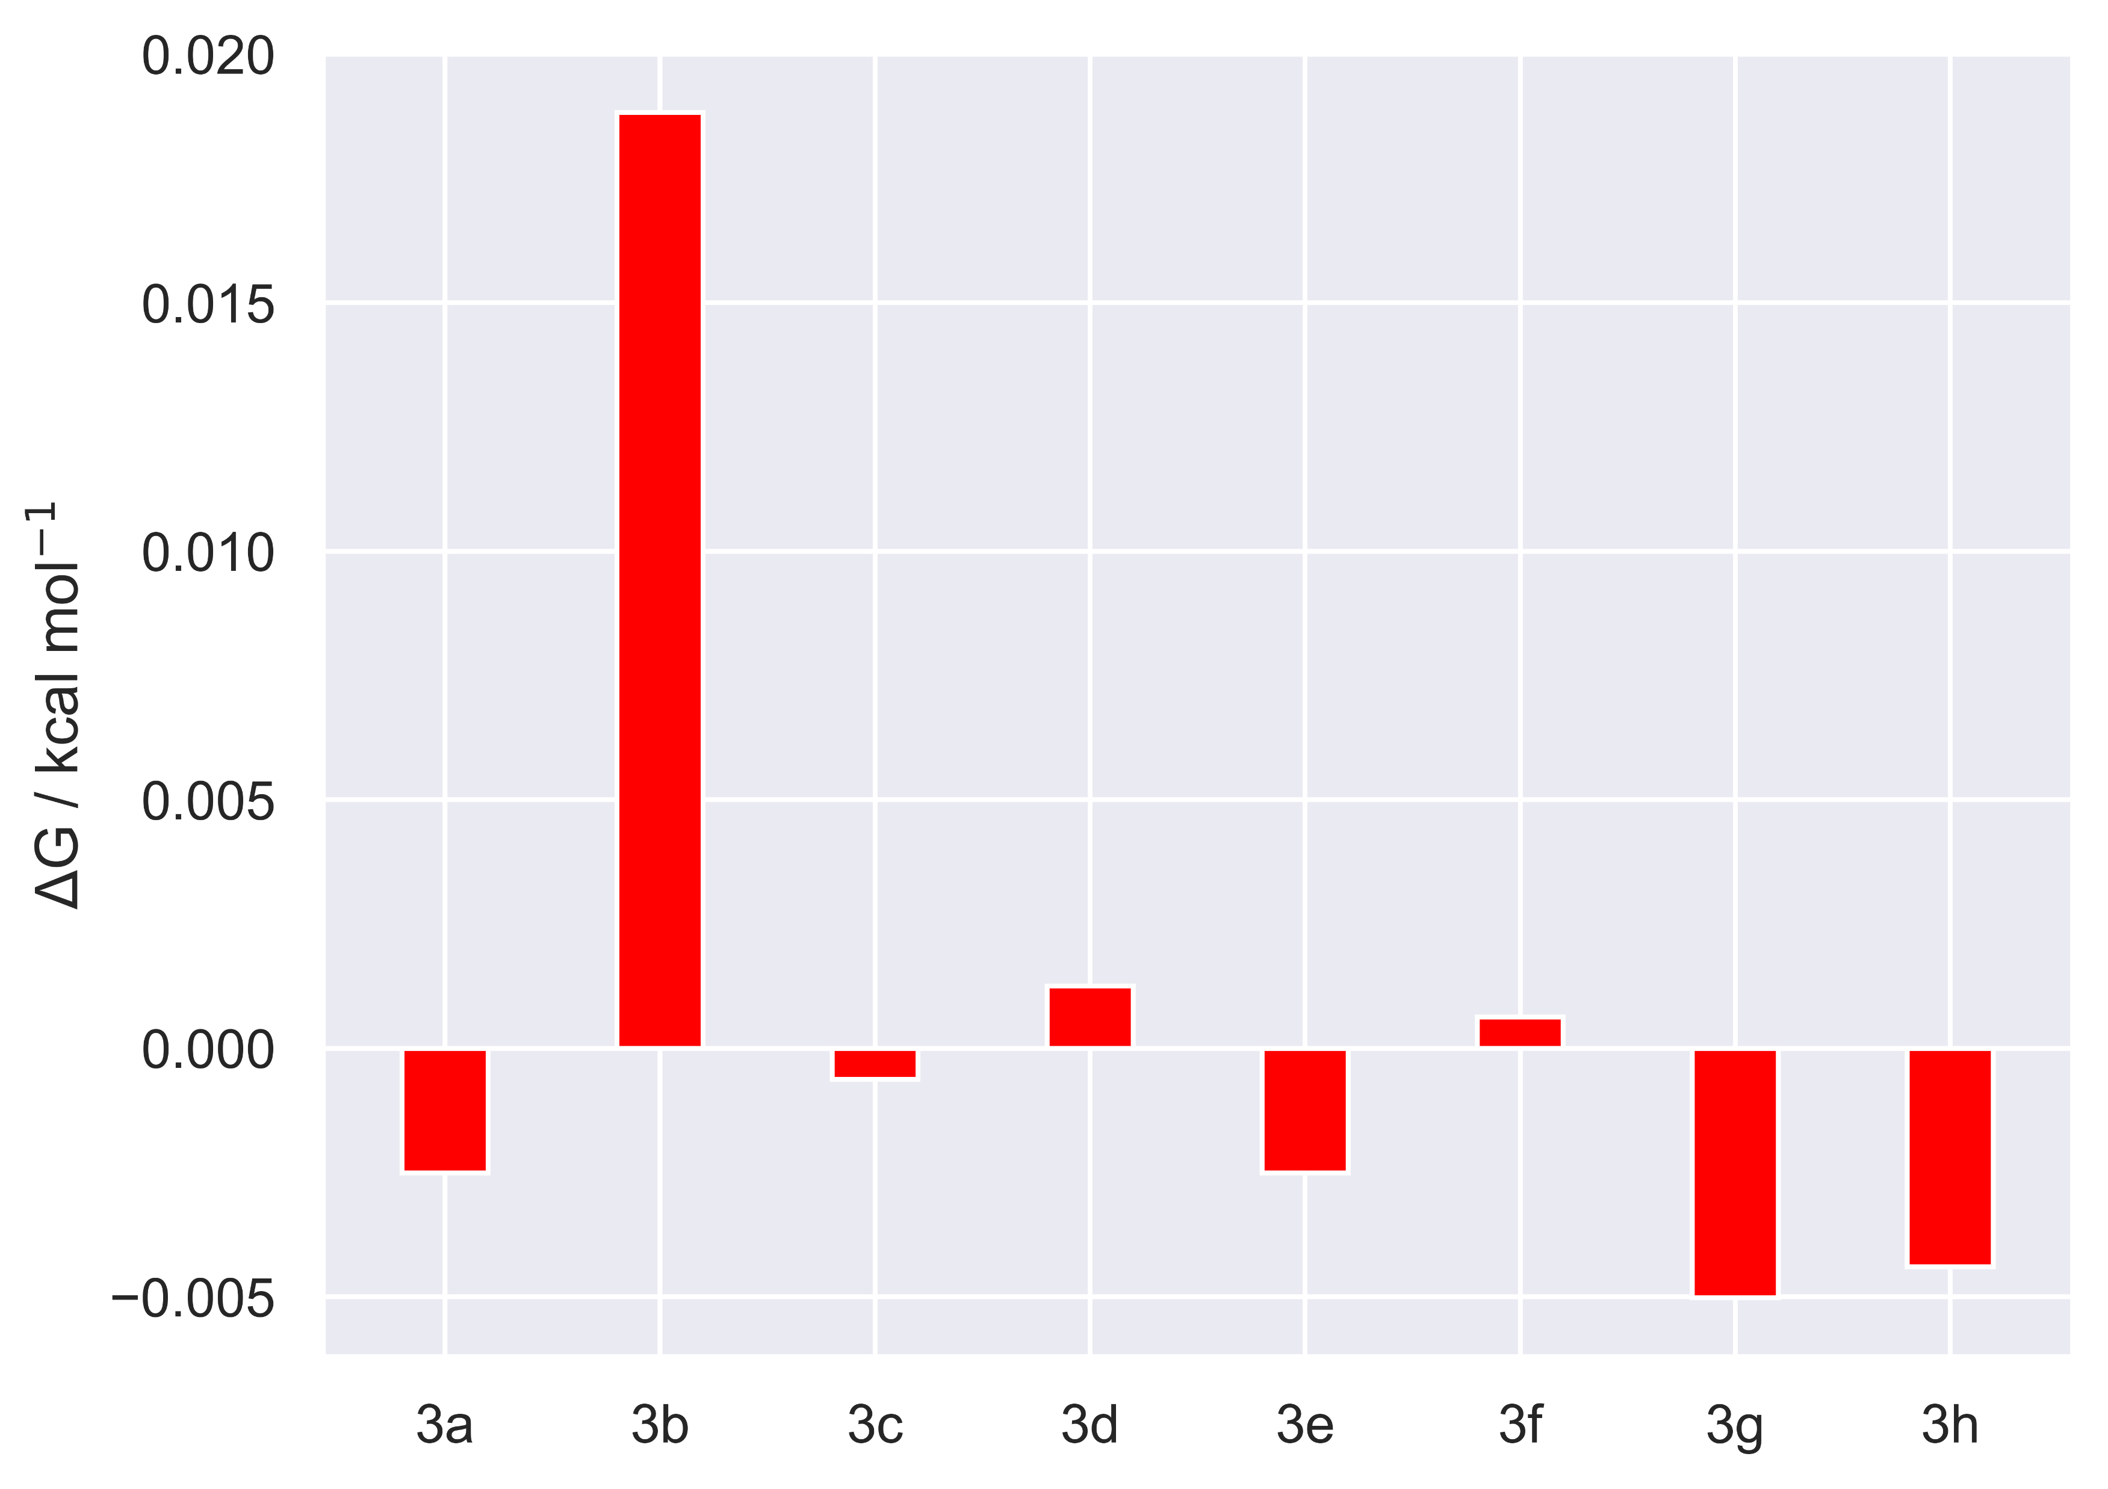
Intra-8: results

Slide 8
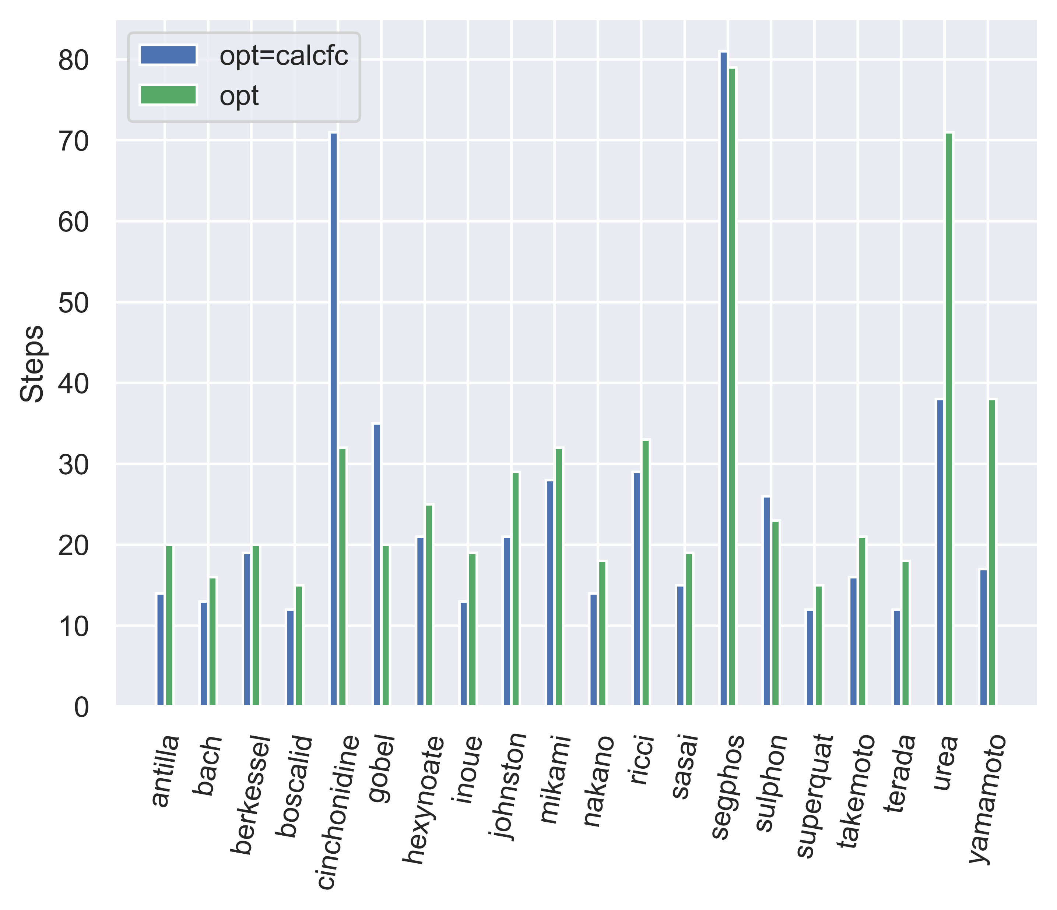
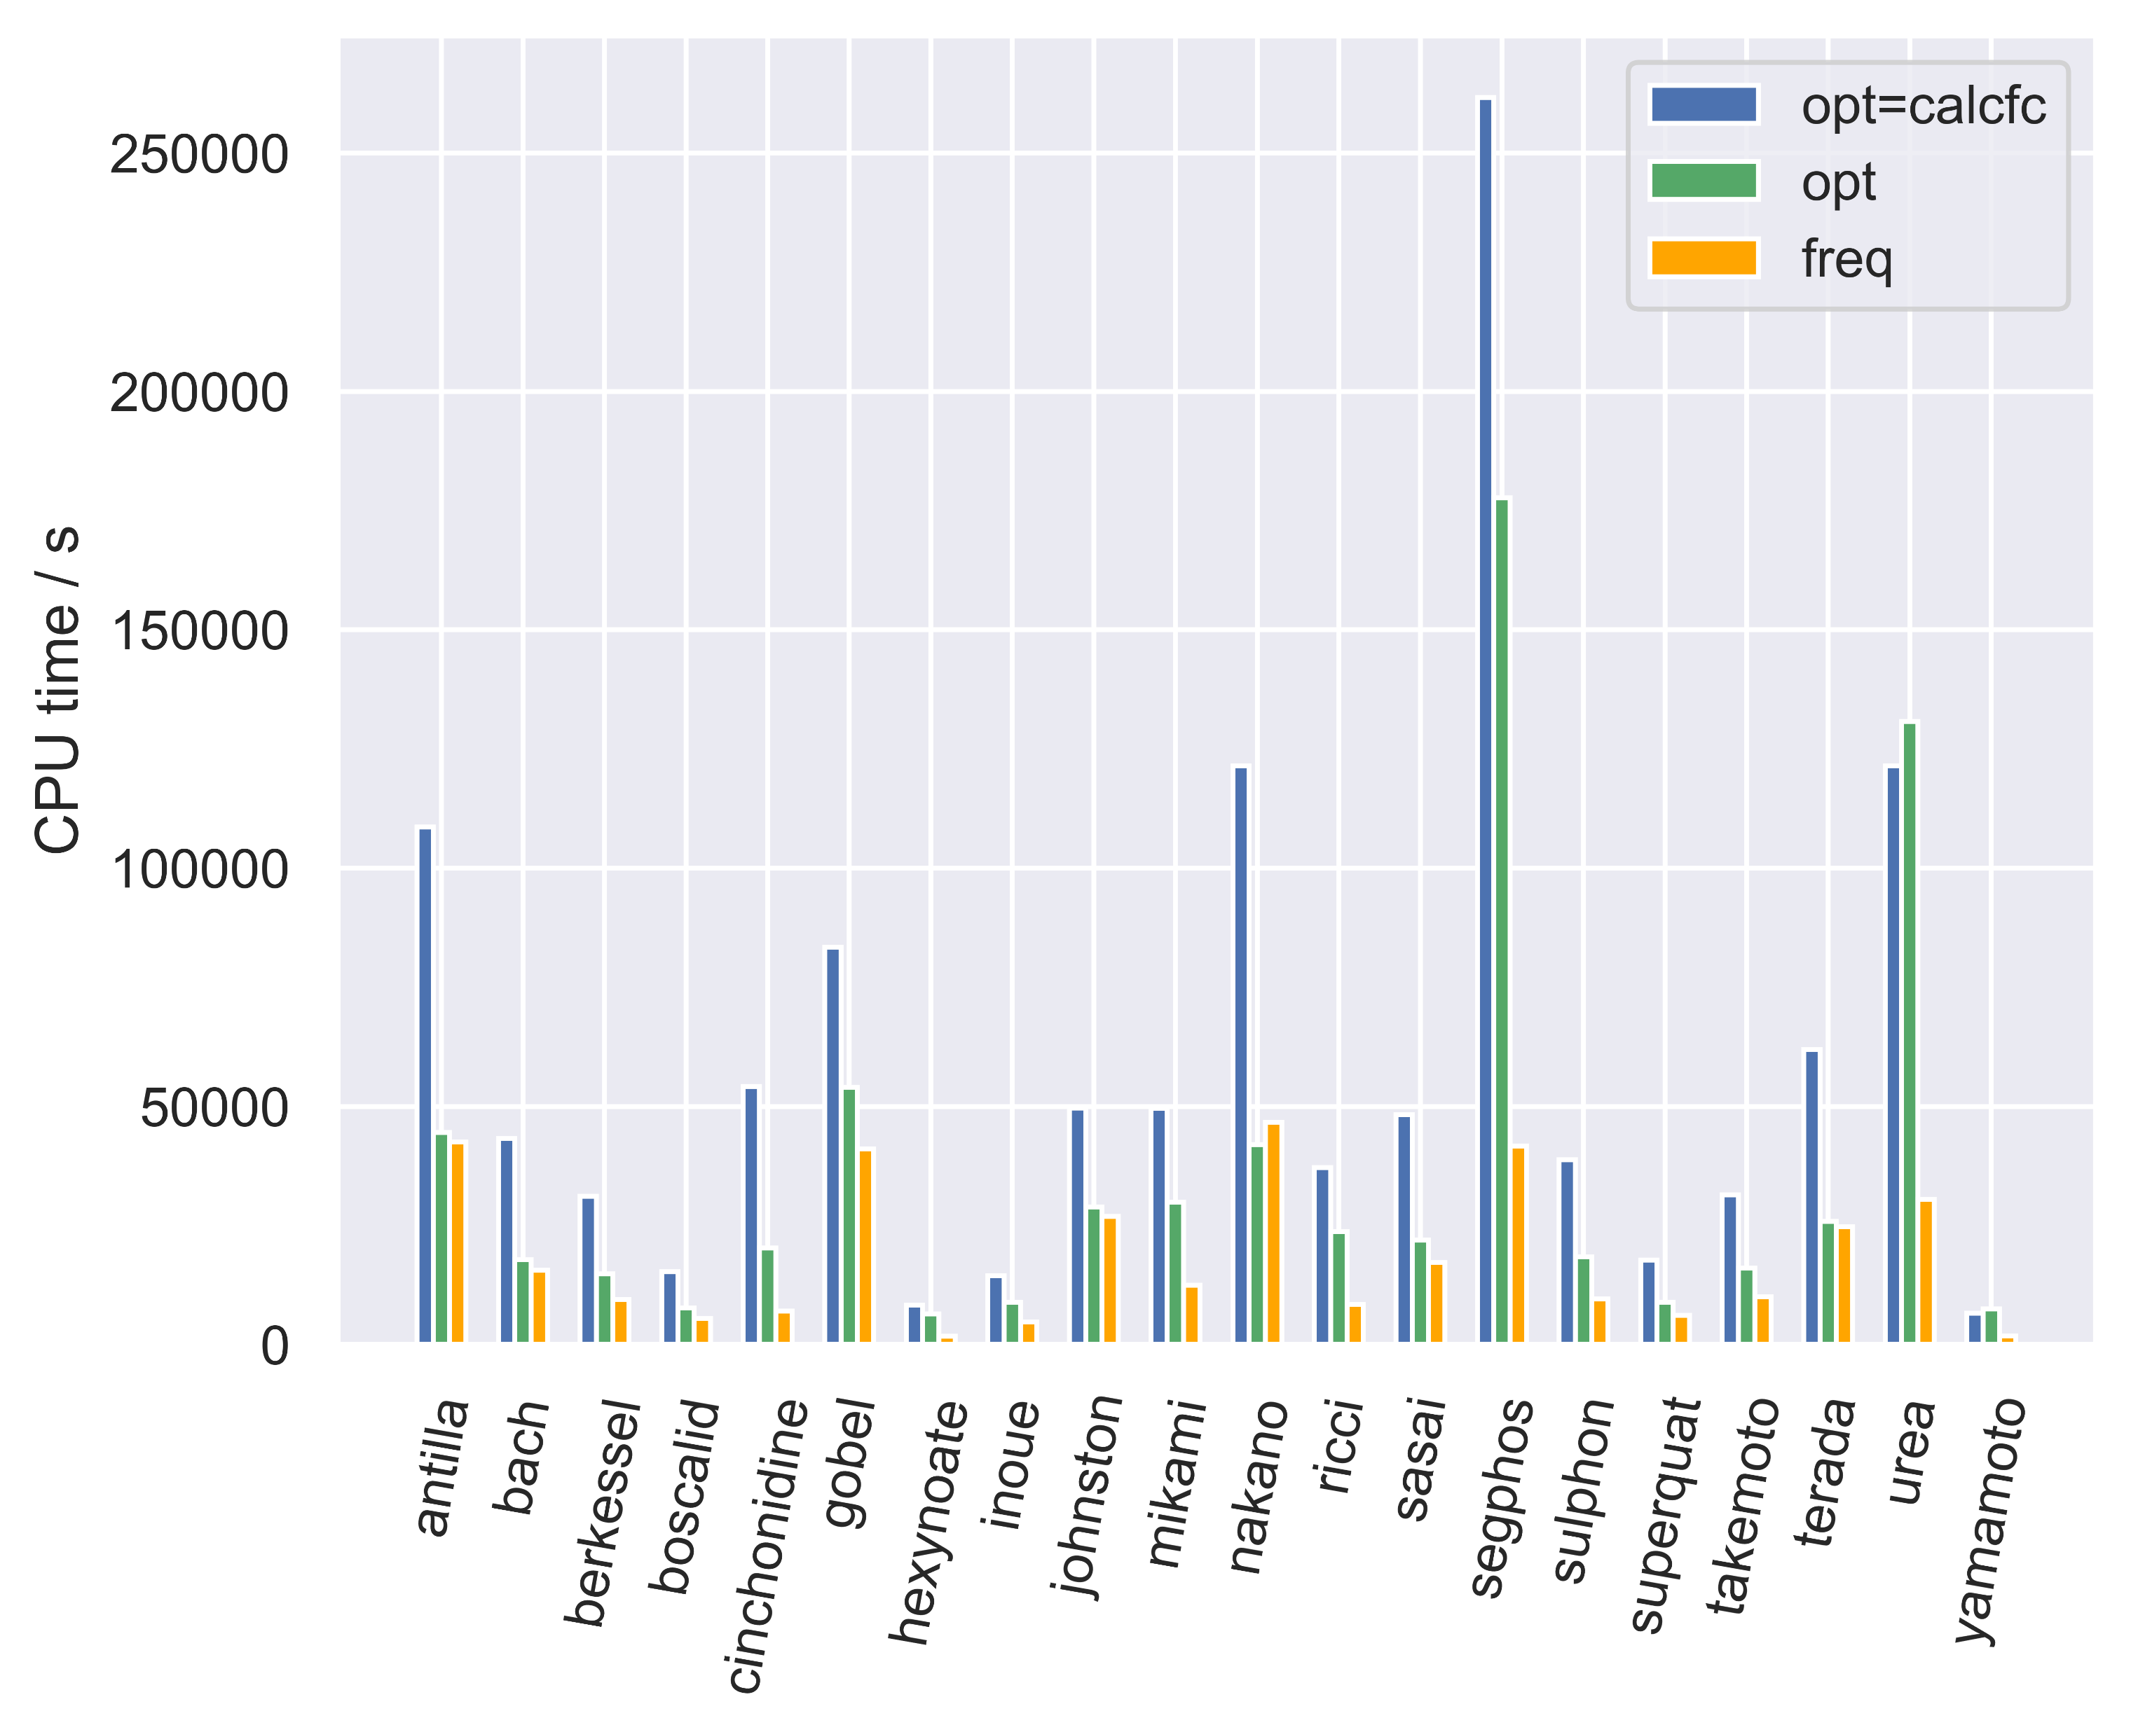
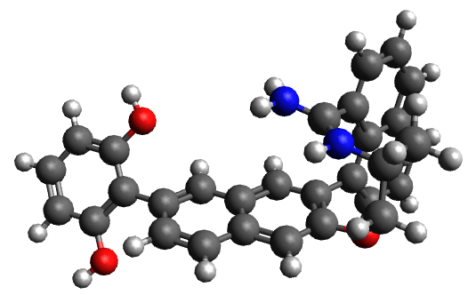
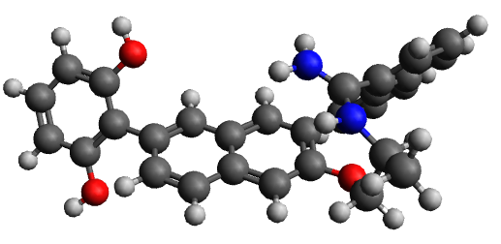
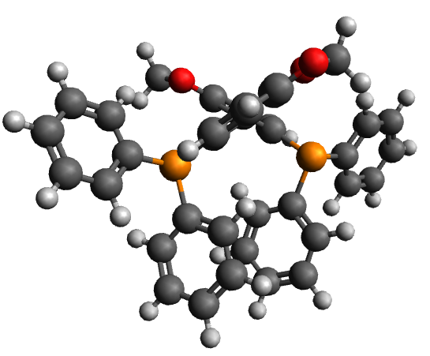
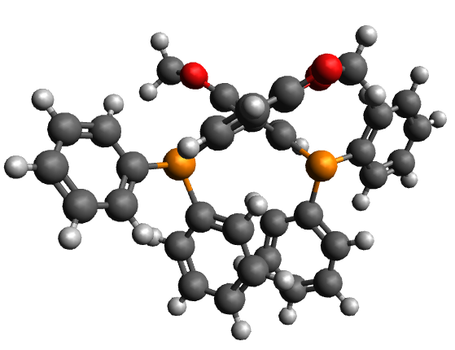
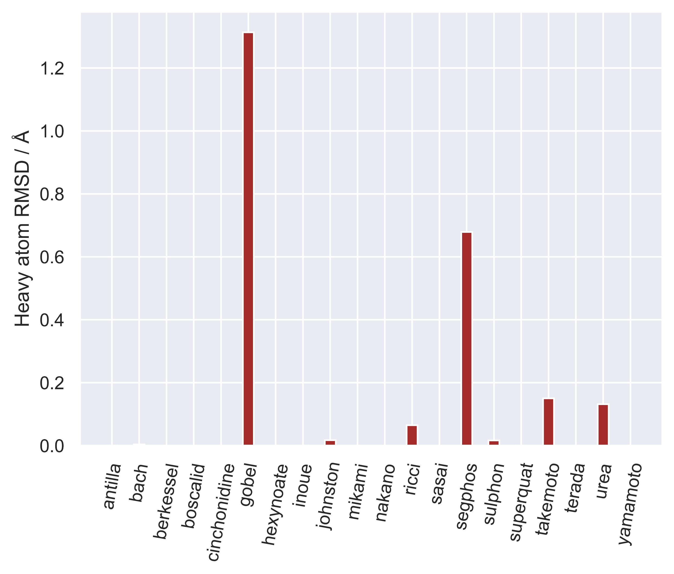
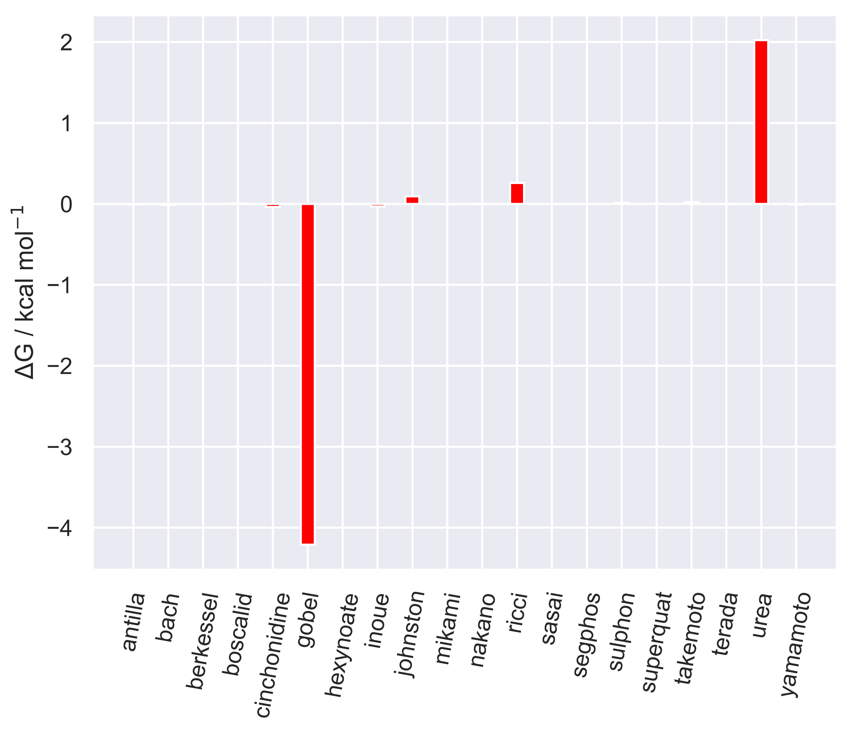
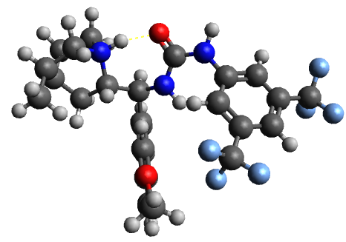
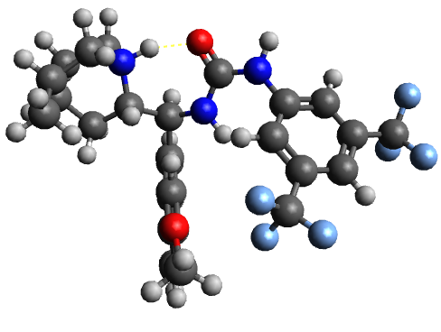
Catalysts-20: results
gobel-opt gobel-opt=calcfc
segphos-opt segphos-opt=calcfc
*
*
urea_cinchona-opt urea_cinchona-opt=calcfc
*
*

Slide 9
Conclusions
opt usually takes a similar number of steps as opt=calcfc, although often slightly more steps
opt usually takes approximately half the CPU time as opt=calcfc, however it can sometimes
take just as much time as the full calculation with an initial exact hessian
opt can sometimes optimise to a different local minima than opt=calcfc, as measured by ΔG and heavy atom RMSD, and this minima can be higher in free energy (e.g. anti-Houk) or lower in free energy (e.g. gobel – although DFT is not a variational method)
The opt approximate Hessian is based on a simple valence force field, therefore an SQM Hessian initial guess may be able to more closely approximate the DFT Hessian and potentially alleviate the problem of multiple conformers, to some extent

